Slide 1
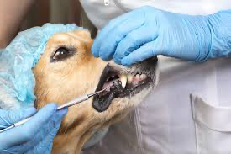
Proof of Concept (POC) for a Vaccine to Prevent
Periodontal Disease in Dogs
Data Analytics, UC Berkeley Boot Camp
June 2022
Final Project:
Kanine_Means
Presented by:
Chandramahanti, Jayanti
Lehmier, Tim
Pill, Lucy

Slide 2
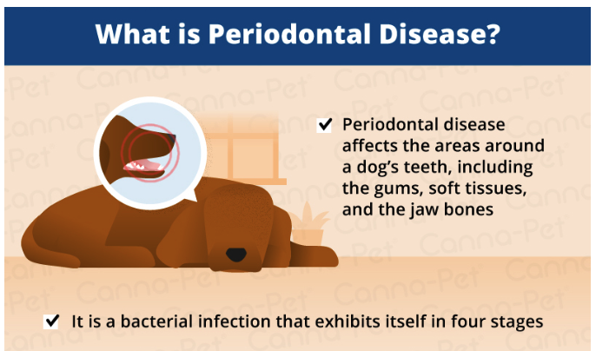
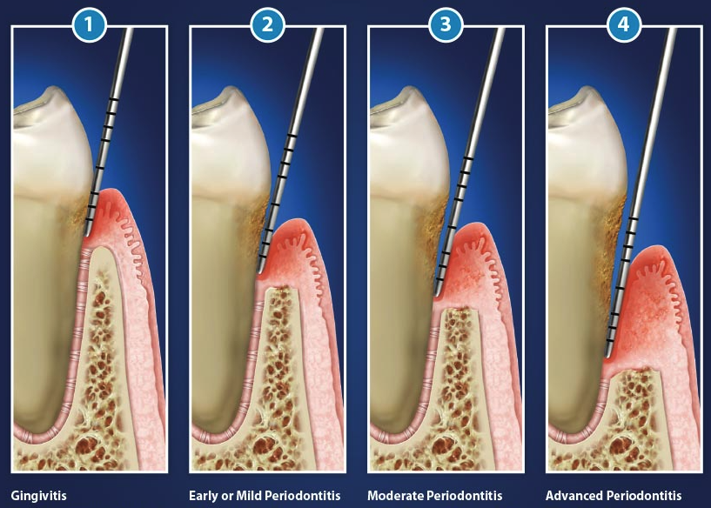
What is periodontal Disease?
https://canna-pet.com/articles/periodontal-disease-senior-dogs/
https://www.deardoctor.com/articles/understanding-periodontal-pockets/
Gingivitis: Tartar begins building up and gums begin swelling
Mild Periodontitis: Gums continue to be swollen and bone loss begins to develop
Moderate Periodontitis: Bone loss continues to occur
Advance Periodontitis: Severe bone loss can lead to loss of teeth and bloody gums.

Slide 3
What Causes Periodontal Disease in Dogs?
What Can Happen if You Don’t Treat Gum Disease in Dogs?
Plaque accumulation
Plaque contains tons of harmful bacteria that cause periodontal disease
Plaque forms in a clean mouth after 24 hours
After 72 hours, that plaque will become mineralized and turn into dental calculus—often referred to as tartar
Plaque on the teeth will cause inflammation of the gums (gingivitis, Stage 1) and then it will make its way down to deeper structures around the tooth
The body’s own inflammatory response to the plaque will then lead to destruction of the soft tissues and bone that support the teeth (periodontitis, Stages 2 through 4).
When gum disease goes untreated, not only is it painful to your dog, but it can wreak havoc on their entire body.
Jaw Fractures
Tooth Abscesses
Eye Issues
Oral Cancers
Increased Risk of Organ Damage
Periodontal disease is known to increase the risk of chronic kidney disease, liver disease, and heart disease in dogs.¹
It can also make it harder to regulate blood sugar in dogs with diabetes.¹
Notes:
…./ Oronasal Fistulas, Gum disease in dogs can also have harmful effects on distant organs in the body

Slide 4
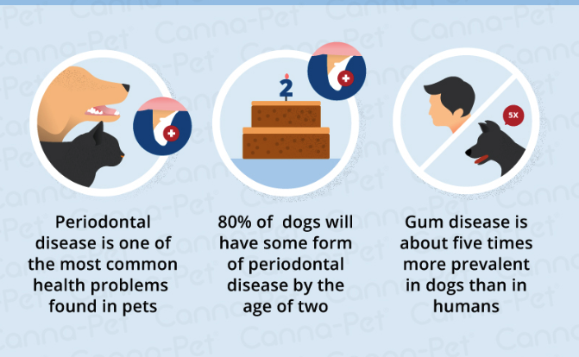
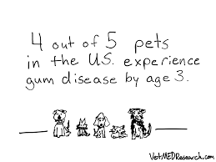
Why a Vaccine for Periodontal Disease for Dogs?
How Much Does Periodontal Disease Cost in Dogs ?
“Visits to veterinary dental specialists for cleaning and extractions costs anywhere from $2,000-$3,000”
Any dental procedure include:
Pre-anesthesia blood work
A complete set of dental x-rays
IV catheter and IV fluids
Circulating warm air to ensure patient stays warm while under anesthesia
Endotracheal intubation, oxygen and inhaled anesthetic
Scaling, polishing and lavage of gingival areas
Local anesthetic such as novocaine, if any extractions are needed
Anesthesia monitoring
Pain medication during and after procedure
https://www.petmd.com/dog/conditions/mouth/c_multi_periodontal_disease#periodontal-disease-dogs
“Root canals are charged by the root,” says Dr. Jeff Werber, DVM. “A three-rooted tooth could range between $1,000-$3,000, depending on the root. Teeth like the upper fourth premolar, which is a three-rooted tooth, would essentially be considered three root canals.”

Slide 5
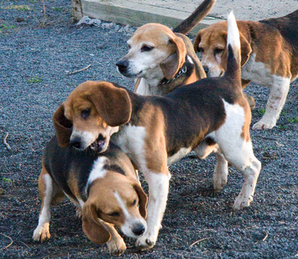
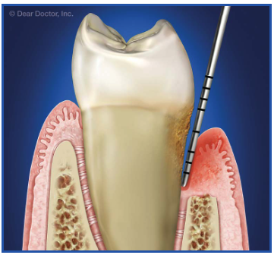
Study Design
1
4
2
3
02
02
Sampling procedure/Design
Process of collecting measurement for analysis
Blood collection/pocket measurements (mm)
Initial question and precise formulation
Measurements
Data analysis
Analyze the data
Read off the answer
Make a conclusion
What is the question we want to answer?
Formulate a hypothesis for testing
Take a representative example of the population of interest
Execution
Aa
aaaa
Does the the vaccine provide active acquired immunity?
Protective immunity to periodontal disease caused by P. gulae is conferred by the vaccine
ETL → Python
Tableau → Visualization
Store the transformed data in a database (PostgreSQL)
Data is retrieved by ML-model
Notes:
Take the data from thew previous step

Slide 6
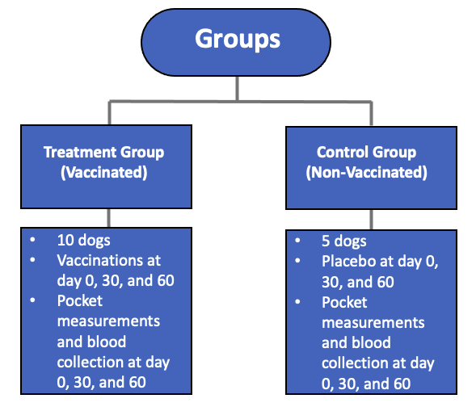
Specifics of Our Study

Slide 7
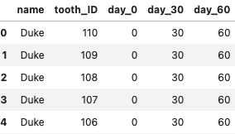
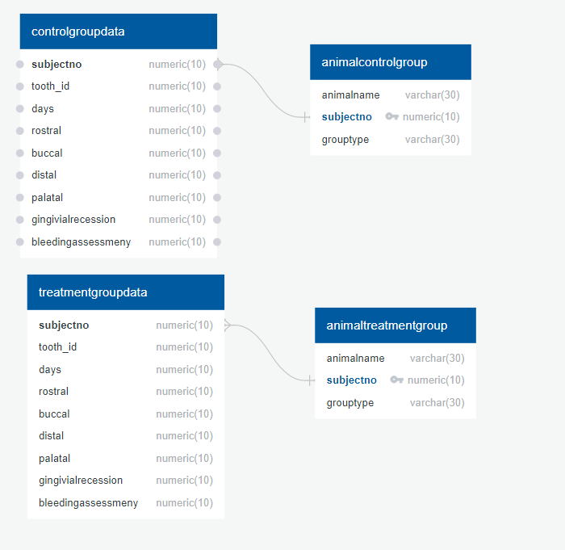
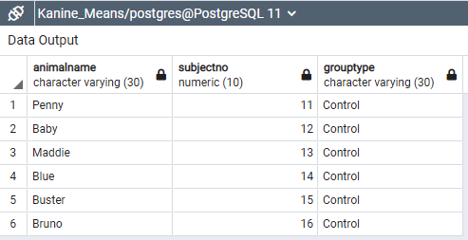
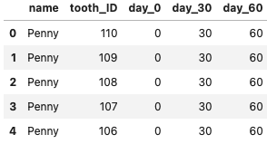
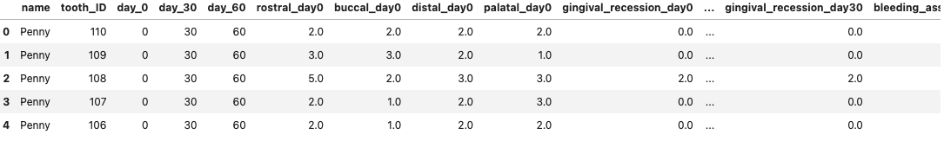
Data Preparation Prior to Analysis
ERD
Data was moved to the database
Connection was confirmed
Data was exported for use in tableau + ML
Several CSVs needed to be cleaned and merger before analysis: Tableau + ML

Slide 8
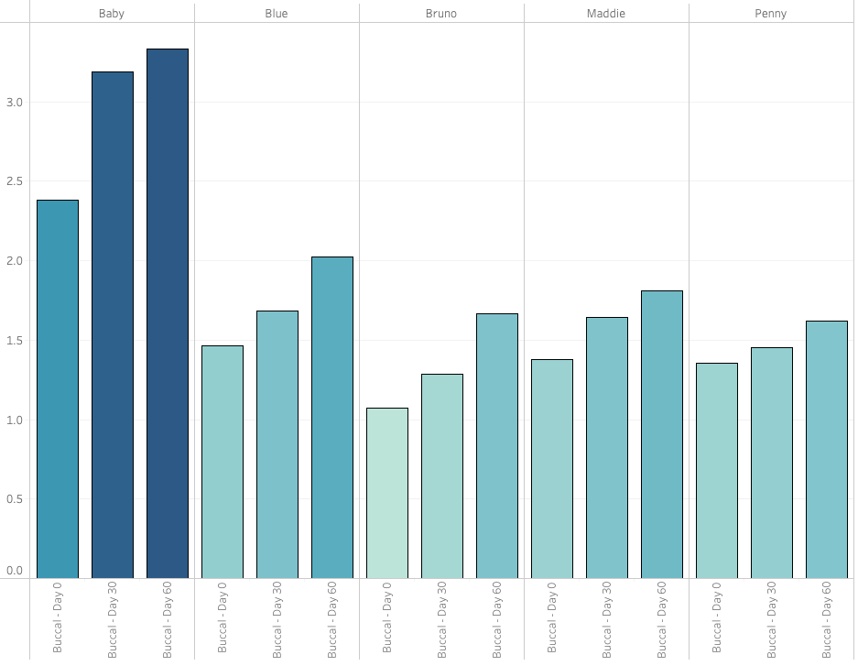
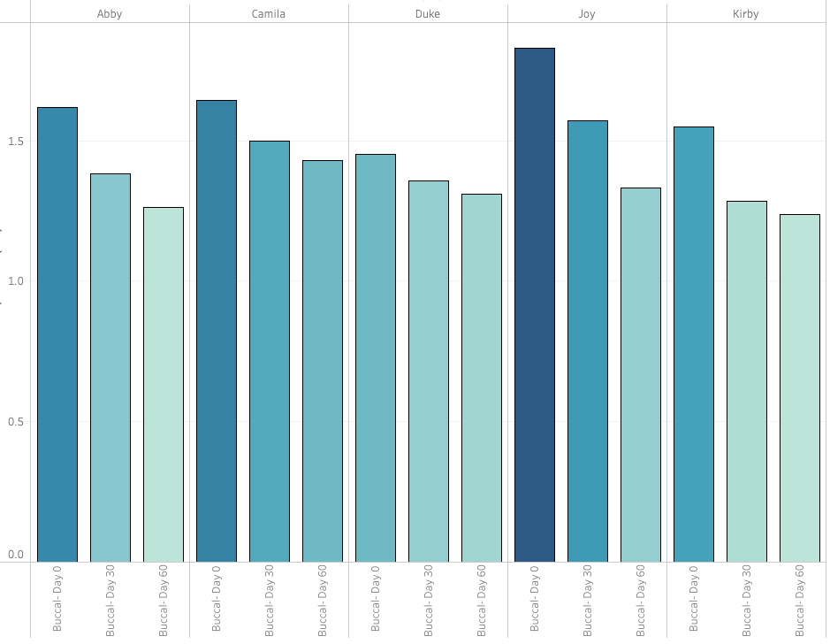
Buccal Position: Control vs. Treatment
Control Group
Treatment Group
Baby
Blue
Bruno
Maddie
Penny
Abby
Camila
Duke
Joy
Kirby
Pocket Depth Aver. in (mm)
Pocket Depth Aver. in (mm)
A
A
0
30
60
0
30
0
60
0
30
60
0
60
0
30
60
A
A
A
A
0
30
60
60
30
0
30
60
0
30
A
A
A
A
0
30
60
60
30
Day
Day
Day
Day
Day
Day
Day
Day
Day
Day
Pocket Depth Increases Overtime
Pocket Depth Decreases Overtime

Slide 9
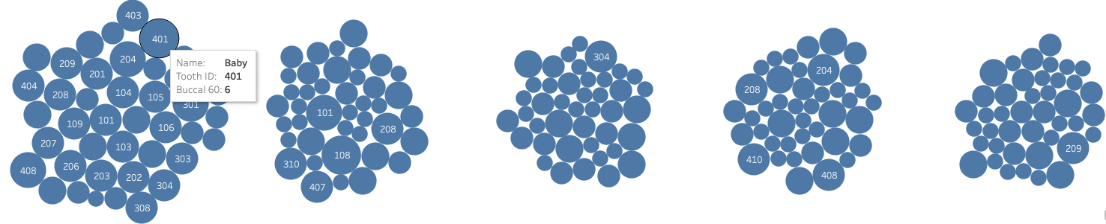
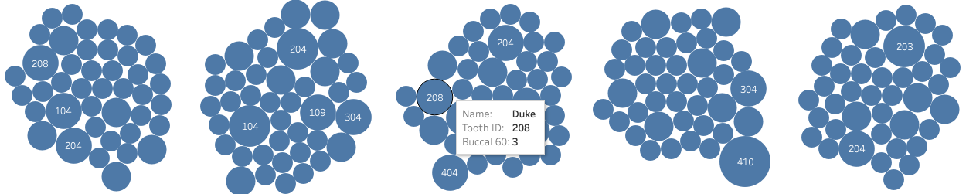
Buccal Teeth with Largest Pockets ay Day 60 Control vs. Treatment
Control
Bruno
Maddie
Penny
Baby
Blue
Treatment
Abby
Camila
Duke
Joy
Kirby
No much difference here both groups have similar teeth with large pockets

Slide 10
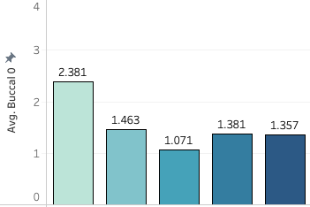
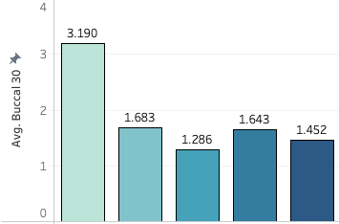
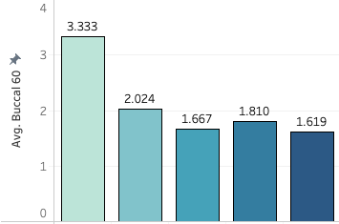
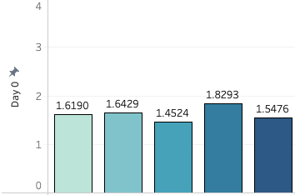
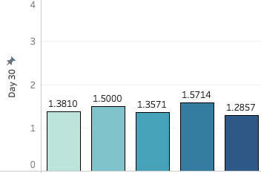
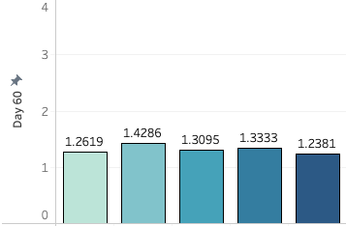
Buccal Position Average Pocket Depth at Day 0, 30, and 60 Control vs Treatment
1.32 mm
1.85 mm
2.09 mm
Control
Pocket depth increases overtime
Day 0
Day 3 0
Day 60
Baby
Blue
Bruno
Maddie
Penny
Baby
Blue
Bruno
Maddie
Penny
Baby
Blue
Bruno
Maddie
Penny
1.61 mm
1.42 mm
1.31 mm
Treatment
Pocket depth Decreases overtime
Day 0
Day 3 0
Day 60
Abby
Camila
Duke
Joy
Kirby
Abby
Camila
Duke
Joy
Kirby
Abby
Camila
Duke
Joy
Kirby

Slide 11
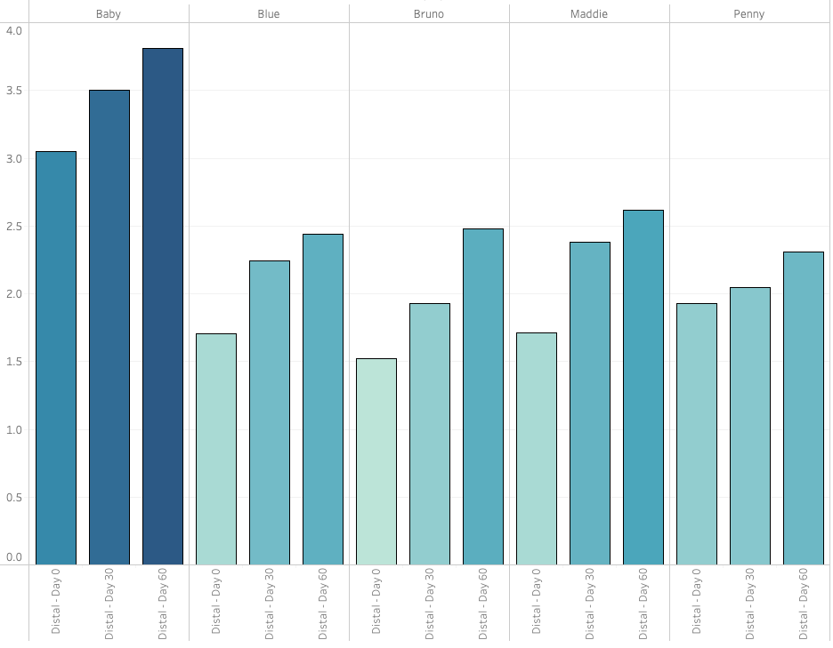
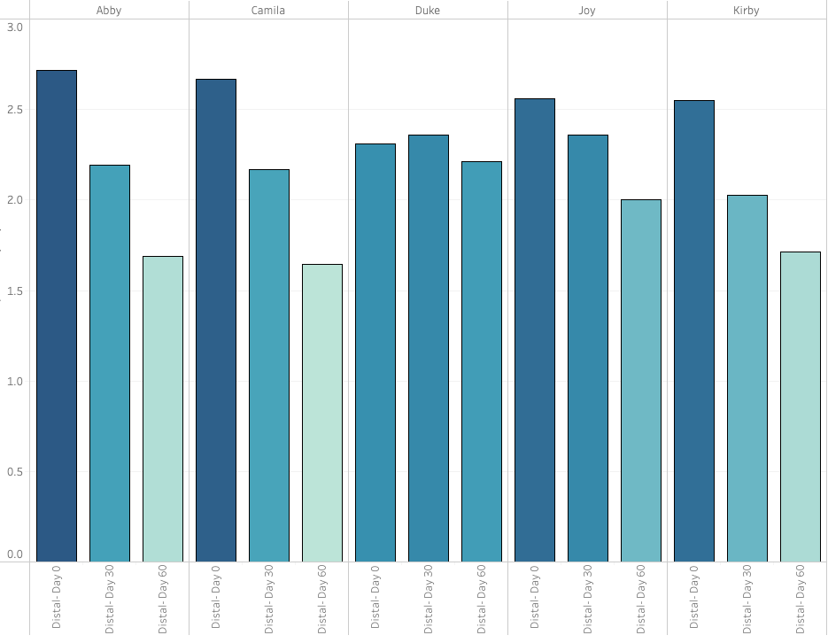
Distal Position: Control vs. Treatment
Control Group
Treatment Group
Baby
Blue
Bruno
Maddie
Penny
Abby
Camila
Duke
Joy
Kirby
Pocket Depth Aver. in (mm)
Pocket Depth Aver. in (mm)
0
30
60
30
60
0
30
60
A
A
A
60
A
0
A
0
30
0
30
60
0
30
0
30
0
60
0
60
60
0
30
60
60
30
A
A
A
A
A
30
Day
Day
Day
Day
Day
Day
Day
Day
Day
Day
Pocket Depth Increases Overtime
Pocket Depth Decreases Overtime

Slide 12
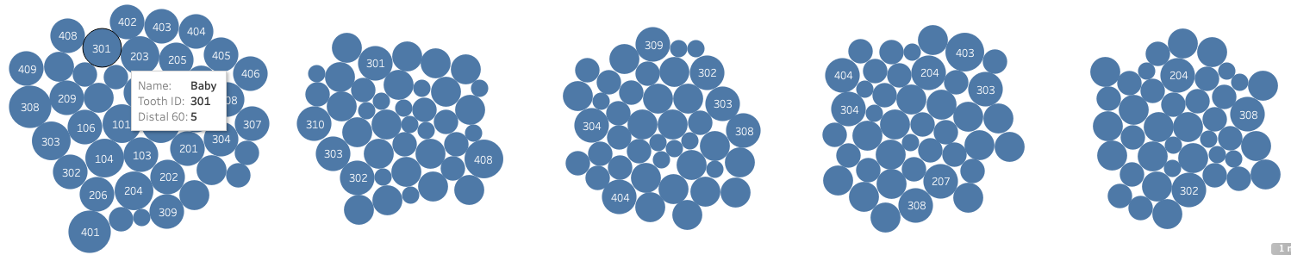
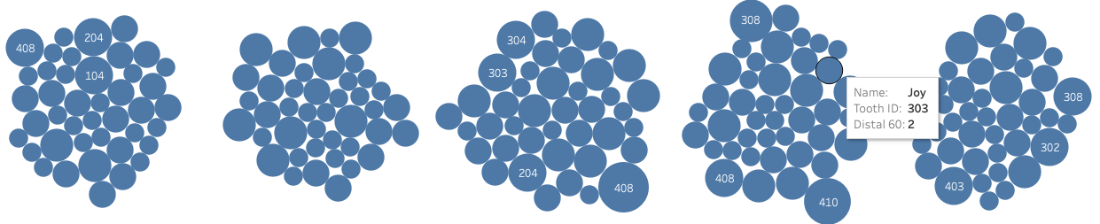
Distal Teeth with Largest Pockets at Day 60 Control vs. Treatment
Control
Baby
Blue
Bruno
Maddie
Penny
Treatment
Abby
Camila
Duke
Joy
Kirby
Comparable to the buccal position teeth in this position seems to be less affected, except for Baby in the control group

Slide 13
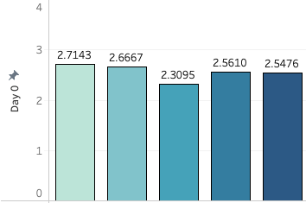
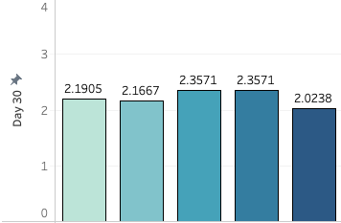
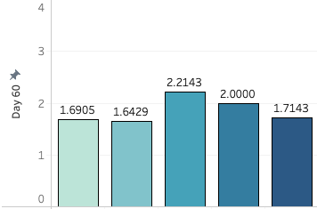
Distal Position Average Pocket Depth at Day 0, 30, and 60 Control vs Treatment
1.32 mm
1.85 mm
2.09 mm
Control
Pocket depth increases overtime
Day 0
Day 3 0
Day 60
Baby
Blue
Bruno
Maddie
Penny
Baby
Blue
Bruno
Maddie
Penny
Baby
Blue
Bruno
Maddie
Penny
2.55 mm
2.21 mm
1.85 mm
Treatment
Pocket depth Decreases overtime
Day 0
Day 3 0
Day 60
Abby
Camila
Duke
Joy
Kirby
Abby
Camila
Duke
Joy
Kirby
Abby
Camila
Duke
Joy
Kirby

Slide 14
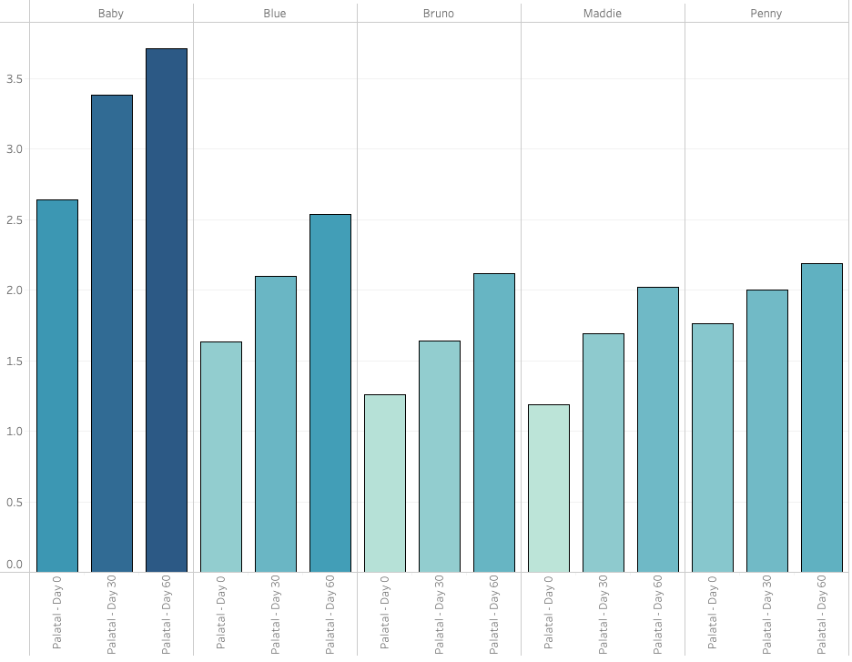
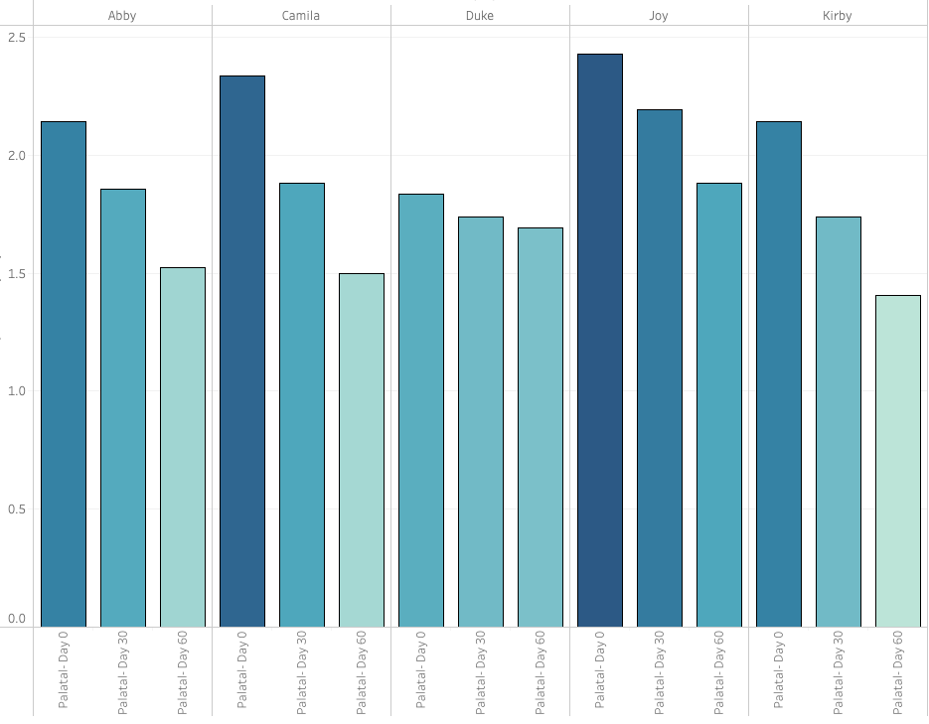
Palatal Position: Control vs. Treatment
Control Group
Treatment Group
Baby
Blue
Bruno
Maddie
Penny
Abby
Camila
Duke
Joy
Kirby
Pocket Depth Aver. in (mm)
Pocket Depth Aver. in (mm)
0
30
60
0
30
60
0
30
60
0
A
0
30
60
A
A
A
30
60
A
A
A
60
A
A
0
30
60
0
30
60
0
30
0
30
60
0
30
60
A
Day
Day
Day
Day
Day
Day
Day
Day
Day
Day
Pocket Depth Increases Overtime
Pocket Depth Decreases Overtime

Slide 15
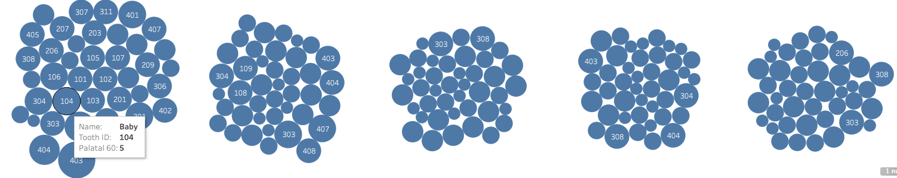
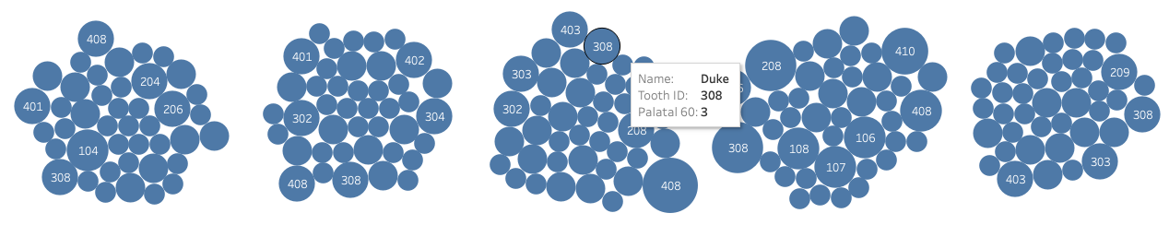
Palatal Teeth with Largest Pockets at Day 60 Control vs. Treatment
Control
Baby
Blue
Bruno
Maddie
Penny
Treatment
Abby
Camila
Duke
Joy
Kirby
Teeth in this position seems to be more affected than teeth in the buccal position

Slide 16
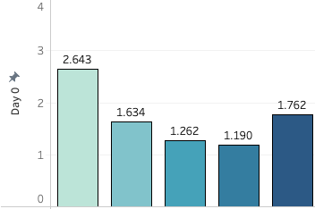
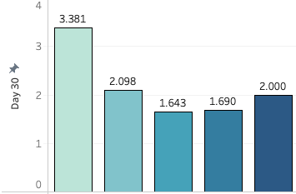
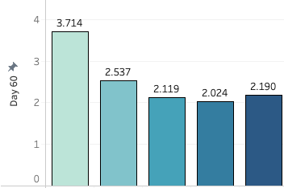
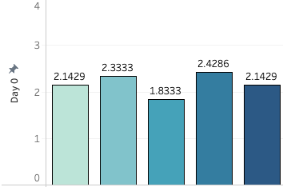
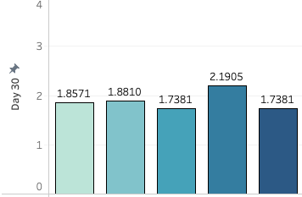
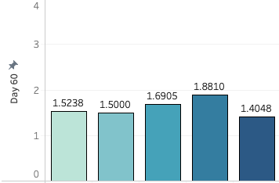
Palatal Position Average Pocket Depth at Day 0, 30, and 60 Control vs Treatment
1.69 mm
2.16 mm
2.51 mm
Control
Pocket depth increases overtime
Day 0
Day 3 0
Day 60
Baby
Blue
Bruno
Maddie
Penny
Baby
Blue
Bruno
Maddie
Penny
Baby
Blue
Bruno
Maddie
Penny
2.17 mm
1.88 mm
1.60 mm
Treatment
Pocket depth Decreases overtime
Day 0
Day 3 0
Day 60
Abby
Camila
Duke
Joy
Kirby
Abby
Camila
Duke
Joy
Kirby
Abby
Camila
Duke
Joy
Kirby

Slide 17
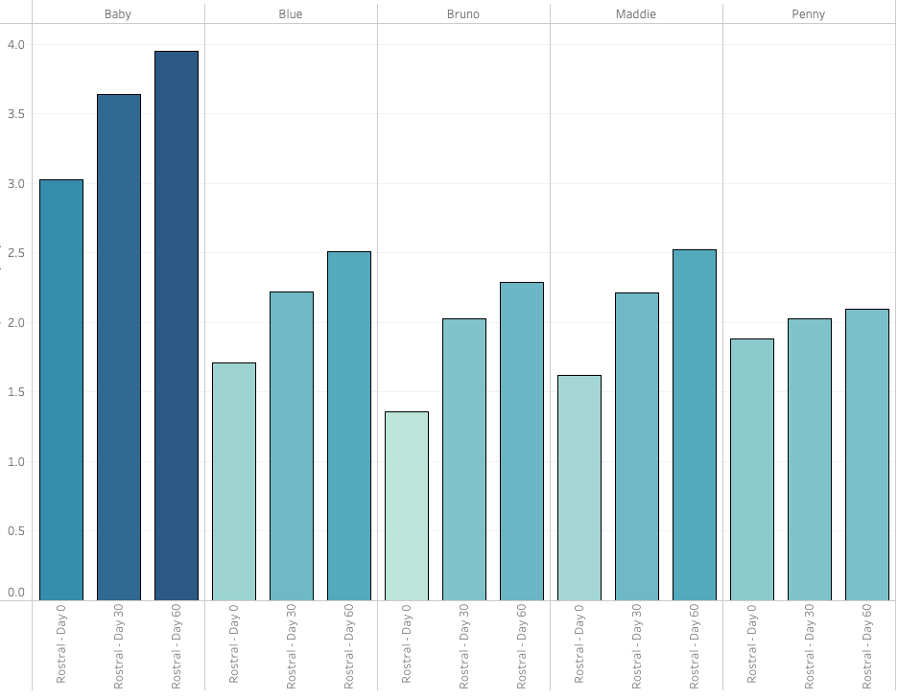
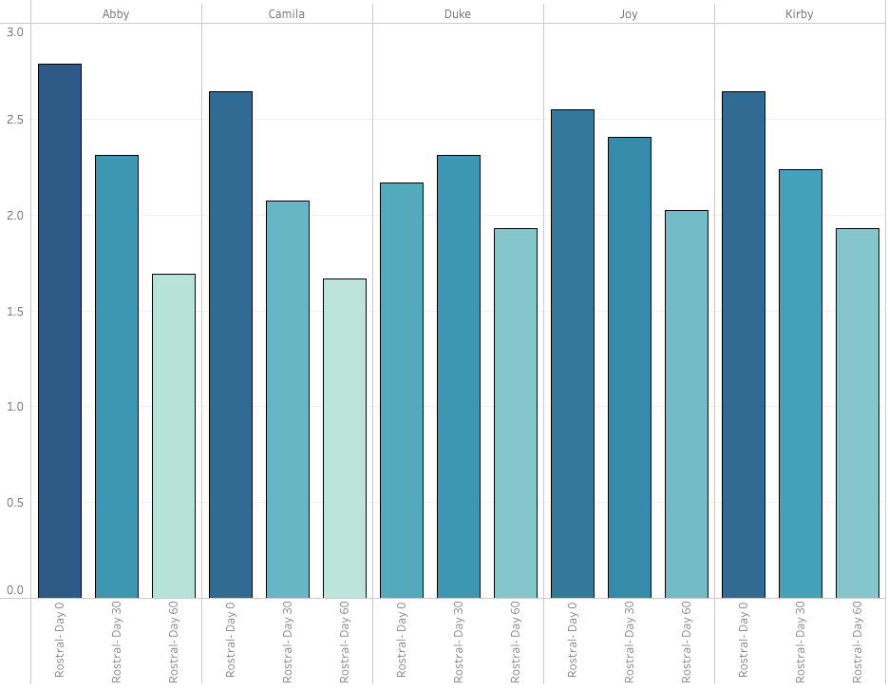
Rostral Position: Control vs. Treatment
Control Group
Treatment Group
Baby
Blue
Bruno
Maddie
Penny
Abby
Camila
Duke
Joy
Kirby
Pocket Depth Aver. in (mm)
Pocket Depth Aver. in (mm)
0
30
60
0
30
60
0
30
60
0
A
0
30
60
A
A
A
30
60
A
A
A
0
30
60
0
30
60
0
30
60
0
30
60
0
30
60
A
A
A
Day
Day
Day
Day
Day
Day
Day
Day
Day
Day
Pocket Depth Increases Overtime
Pocket Depth Decreases Overtime

Slide 18
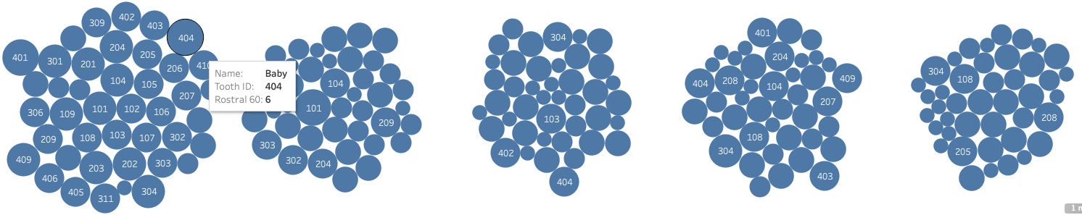
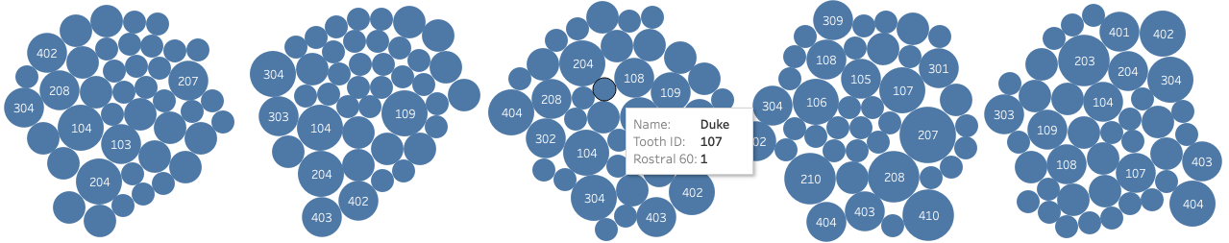
Rostral Teeth with Largest Pockets at Day 60 Control vs. Treatment
Control
Baby
Blue
Bruno
Maddie
Penny
Treatment
Abby
Camila
Duke
Joy
Kirby
Teeth in the rostral position are more for both groups

Slide 19
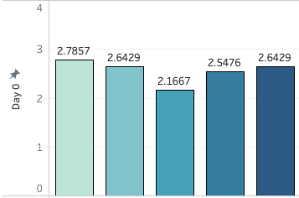
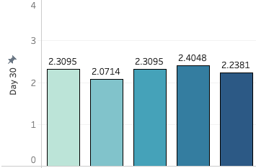
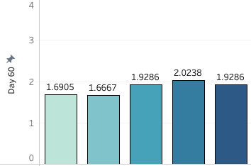
Rostral Position Average Pocket Depth at Day 0, 30, and 60 Control vs Treatment
1.69 mm
2.16 mm
2.51 mm
Control
Pocket depth increases overtime
Day 0
Day 3 0
Day 60
Baby
Blue
Bruno
Maddie
Penny
Baby
Blue
Bruno
Maddie
Penny
Baby
Blue
Bruno
Maddie
Penny
2.55 mm
2.26 mm
1.84 mm
Treatment
Pocket depth Decreases overtime
Day 0
Day 3 0
Day 60
Abby
Camila
Duke
Joy
Kirby
Abby
Camila
Duke
Joy
Kirby
Abby
Camila
Duke
Joy
Kirby

Slide 20
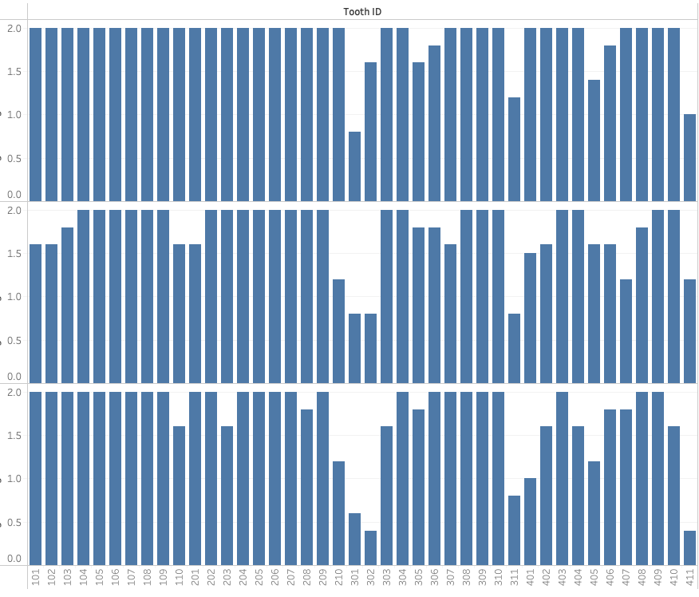
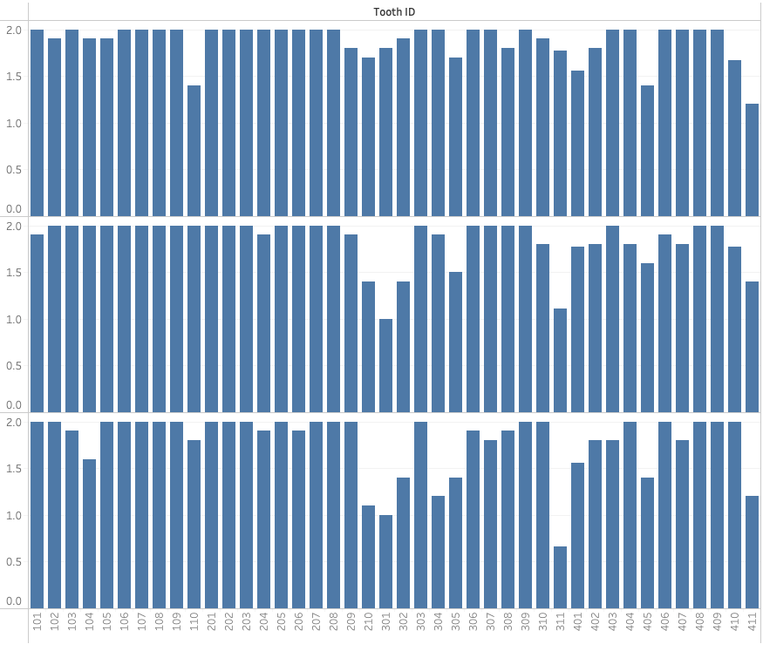
Average Bleeding Assessment per Tooth at Days 0, 30, and 60
Control Group
Treatment Group
Tooth ID
Tooth ID
Day 0
Day 30
Day 60
Both groups show similar trend: Teeth 210, 301, and 302 have the lower average

Slide 21
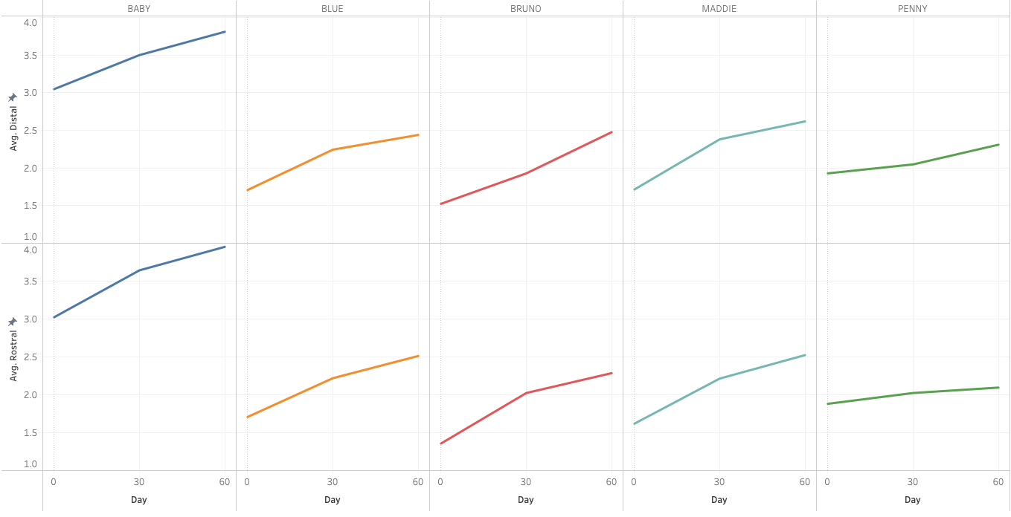

Rostral and Distal Position: Control vs Treatment at Day 0, 30, and 60
Baby
Blue
Bruno
Maddie
Penny
Abby
Camila
Duke
Joy
Kirby
Average Distal (mm)
Average Distal (mm)
Average Rostral (mm)
Average Rostral (mm)
0
30
60
0
30
60
0
30
60
0
30
60
0
30
60
0
30
60
0
30
60
0
30
60
0
30
60
0
30
60
Day
Day
Day
Day
Day
Day
Day
Day
Day
Day
Control:
Same trend as time passes the severity of pocket depth increases
Treatment:
Same trend as time passes the severity of pocket depth Decreases

Slide 22
Machine Learning Model

Slide 23


Summary
Control
Pocket depth decreased overtime in the treated group compared to the control group
Two positions distal and rostral in both groups have the higher aver. Pocket depth when compared to distal and palatal
The trend for both group was consistent. The control group is getting worse whereas the treatment group is getting better
ML PREDITION MODEL…
Treatment

Slide 24
Next Steps and Suggestions

